Slide 1

REVIEW-02

Slide 2
ENHANCED ER DIAGRAM

Slide 3
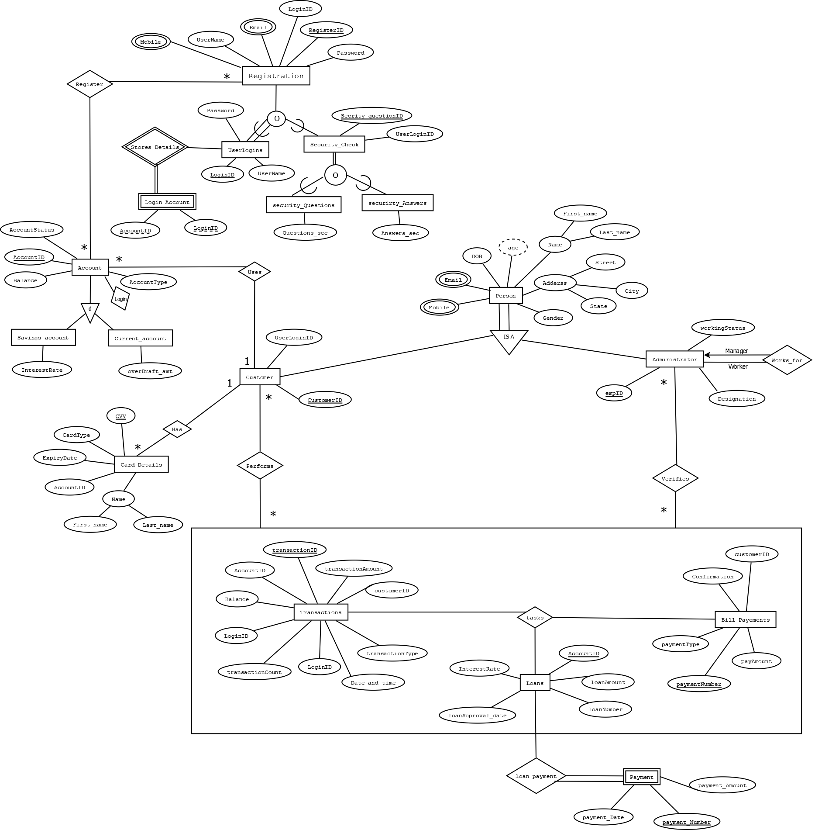

Slide 4
NORMALISATION

Slide 5
NORMALISATION
TABLES BEFORE NORMALISATION:
ADMINISTRATOR (Emp_id, Emp_firstName, Emp_lastName,
Emp_Gender, Emp_DOB,Emp_Designation, Emp_Designation, Hired_date, Emp_workingStatus)
CUSTOMER (Customer_id, AccountID, Customer_firstName,
Customer_lastName,Customer_Gender, DOB,
State,City, Customer_Address, Zip_code,Email_Id,
Mobile_no1,Mobile_no2, UserLoginID)
REGISTRATION (RegisterID, UserName, UserLoginID, Password, Email_Id, Mobile_no1)
LOGIN-ACCOUNT (UserLoginID, AccountID)
USERLOGINS (UserLoginID, UserName, Password)

Slide 6
CONT.
SECURITYANSWERS (UserLoginID, Security_Ans, Security_QuestID)
SECURITYQUESTIONS (Security_QuestID, Security_Questions)
TRANSACTION (TransactionID, TransactionDate, TransactionTime, TransactionType,
TransactionAmount, NewBalance, AccountID, Customer_id, UserLoginID,
WithdrawalCount, DepositCount)
LOAN-DETAILS (LoanNumber, AccountID, LoanAmount, InterestRate, LoanApprovalDate)
CARD-DETAILS (AccountID, CardHolder, CardType, CCV, ExpirtDate)
BILL-PAYMENTS (BillPayment_no, PaymentType, PaymentConfirmation, PaymentAmount, Customer_id)
FAILEDTRANSACTIONLOG (FailedTransaction_errorType, FailedTransactionID)

Slide 7
MASTER SCHEMA:
BANK (Emp_id, Emp_firstName, Emp_lastName, Emp_Gender, Emp_DOB, Emp_Designation, Hired_date, Emp_workingStatus, Emp_Mobile, Customer_id, AccountID, Customer_firstName, Customer_lastName, Customer_Gender, DOB, State, City, Customer_Address, Zip_code, Email_Id, Mobile_no, UserLoginID, AccountID, CurrentBalance, AccountType, AccountStatus, SavingsInterestRate, RegisterID, UserName, Password, Security_Ans, Security_QuestID, Security_Questions, TransactionID, TransactionDate, TransactionTime, TransactionType, TransactionAmount, NewBalance, WithdrawalCount, DepositCount, LoanNumber, LoanAmount, InterestRate, LoanApprovalDate, CardHolder, CardType, CCV, ExpirtDate, BillPayment_no, PaymentType, PaymentConfirmation, PaymentAmount, FailedTransaction_errorType, FailedTransactionID)

Slide 8
1 NF :
The relations should have primary keys
There should be no repeating groups
Decompose multi values attributes into new tables
Multivariable attributes:
TransactionID,
Mobile_no,
Emp_Mobile,
LoanNumber,
BillPayment_no.

Slide 9
Table 1:
BANK (Emp_id, Emp_firstName, Emp_lastName, Emp_Gender, Emp_DOB,
Emp_Designation, Hired_date, Emp_workingStatus, Customer_id,
AccountID, Customer_firstName, Customer_lastName, Customer_Gender,
DOB, State, City, Customer_Address, Zip_code, Email_Id,
UserLoginID, AccountID, CurrentBalance, AccountType, AccountStatus,
SavingsInterestRate, RegisterID, UserName, Password,
Security_Ans, Security_QuestID, Security_Questions, TransactionID,
TransactionDate, TransactionTime, TransactionType, TransactionAmount,
NewBalance, WithdrawalCount, DepositCount, LoanNumber,
LoanAmount, InterestRate, LoanApprovalDate, CardHolder, CardType,
CCV, ExpirtDate, BillPayment_no, PaymentType, PaymentConfirmation,
PaymentAmount, FailedTransaction_errorType, FailedTransactionID)

Slide 10
Table 2:
Cus_Mobile (Customer_id, Mobile_no)
Table 3:
Emp_Mob (Emp_id, Emp_Mobile)
Table 4:
Loan_num (Customer_id, LoanNumber)
Table 5:
Transact (AccountID, TransactionID)
Table 6:
Bill (AccountID, Bill_payment_no)

Slide 11
2 NF :
The tables are in 1NF
All the other non-prime attributes should be fully functionally dependent on Candidate keys.
Master Schema is decomposed and all the partial dependencies
are identified.

Slide 12
Table 1:
ADMINISTRATOR (Emp_id, Emp_firstName, Emp_lastName,
Emp_Gender, Emp_DOB, Emp_Designation,
Hired_date, Emp_workingStatus)
Functional Dependencies:
(Emp_id) --> (Emp_firstName, Emp_lastName, Emp_Gender, Emp_DOB, Emp_Designation,
Emp_workingStatus, Hired_date)
Table 2:
CUSTOMER (Customer_id, AccountID, UserLoginID, Customer_firstName, Customer_lastName,
Customer_Gender, DOB, State, City, Customer_Address, Zip_code, Email_Id, Mobile_no)
Functional Dependencies:
(Customer_id) -->(AccountID, UserLoginID, Customer_firstName, Customer_lastName,
Customer_Gender, DOB, State, City, Customer_Address, Zip_code, Email_Id)
Table 3:
ACCOUNT-DETAILS (AccountID, CurrentBalance, AccountType, AccountStatus, SavingsInterestRate)
Functional Dependencies:
(AccountID) --> (CurrentBalance, AccountType, AccountStatus, SavingsInterestRate)

Slide 13
Table 4:
REGISTRATION (RegisterID, UserName, UserLoginID, Password, Email_Id, Mobile)
Functional Dependencies:
(RegisterID, UserLoginID) -> (UserName, Password, Email_Id, Mobile)
Table 5:
TRANSACTION (TransactionID, TransactionDate, TransactionTime, TransactionType, TransactionAmount, NewBalance,
WithdrawalCount, DepositCount)
Functional Dependencies:
(TransactionID) -> (TransactionDate, TransactionTime, TransactionType, TransactionAmount, NewBalance, WithdrawalCount, DepositCount)
Table 6:
LOAN-DETAILS (LoanNumber, LoanAmount, InterestRate, LoanApprovalDate, LoanType)
Functional Dependencies:
(LoanNumber) -> (LoanAmount, InterestRate, LoanApprovalDate, LoanType)

Slide 14
Table 7:
CARD-DETAILS (CardNumber, CardHolder, CardType, CCV, ExpirtDate)
Functional Dependencies:
(CardNumber) -> (CardHolder, CardType, CCV, ExpirtDate)
Table 8:
BILL-PAYMENTS (BillPayment_no, PaymentType, PaymentConfirmation, PaymentAmount)
Functional Dependencies:
(BillPayment_no) -> (PaymentType, PaymentConfirmation, PaymentAmount)
Table 9:
FailedTransactionLog (FailedTransaction_errorType, FailedTransactionID)
Functional Dependencies:
(FailedTransactionID) -> (FailedTransaction_errorType)
Table 10:
USERLOGINS (UserLoginID, UserName, Password)
Functional Dependencies:
(UserLoginID) -> (Username, Password)

Slide 15
PARTIAL DEPENDENCY:
(5a) Security_Ans (UserLoginID, Security_QuestID, Security_Ans)
Functional Dependencies:
(UserLoginID, Security_QuestID) -> (Security_Ans)
(5b) Security_Quest (Security_QuestID, Security_Questions)
Functional Dependencies:
(Security_QuestID) -> (Security_Questions)

Slide 16
3 NF :
If it is in 2NF
There is no transitive functional dependency between non-prime attributes.
Further, the decomposed master schema should be segregated on the basis of transitive dependency.

Slide 17
Table 1:
ADMINISTRATOR (Emp_id, Emp_firstName, Emp_lastName, Emp_Gender, Emp_DOB, Emp_Designation,
Hired_date, Emp_workingStatus)
Functional Dependencies:
(Emp_id) -> (Emp_firstName, Emp_lastName, Emp_Gender, Emp_DOB, Emp_Designation, Emp_workingStatus, Hired_date)
Table 2:
CUSTOMER (Customer_id, AccountID, UserLoginID, Customer_firstName, Customer_lastName, Customer_Gender,
DOB, State, City, Customer_Address, Zip_code, Email_Id, Mobile_no)
Functional Dependencies:
(Customer_id) -> (AccountID, UserLoginID, Customer_firstName, Customer_lastName, Customer_Gender, DOB,
Customer_Address, Email_Id)
Table 3:
ACCOUNT-DETAILS (AccountID, CurrentBalance, AccountType, AccountStatus, SavingsInterestRate)
Functional Dependencies:
(AccountID) -> (CurrentBalance, AccountType, AccountStatus, SavingsInterestRate)

Slide 18
TABLE 4:
REGISTRATION (RegisterID, UserName, UserLoginID, Password, Email_Id, Mobile)
Functional Dependencies:
(RegisterID, UserLoginID) -> (UserName, Password, Email_Id, Mobile)
TABLE 5:
Security_Ans (UserLoginID, Security_QuestID, Security_Ans)
Functional Dependencies:
(UserLoginID, Security_QuestID) -> (Security_Ans)
TABLE 6:
Security_Quest (Security_QuestID, Security_Questions)
Functional Dependencies:
(Security_QuestID) -> (Security_Questions)
TABLE 7:
TRANSACTION (TransactionID, TransactionDate, TransactionTime, TransactionType, TransactionAmount, NewBalance,
WithdrawalCount, DepositCount, OldBalance)
Functional Dependencies:
(TransactionID) ->(TransactionDate, TransactionTime, TransactionType, TransactionAmount, NewBalance,
WithdrawalCount, DepositCount, OldBalance)

Slide 19
TABLE 8:
LOAN-DETAILS (LoanNumber,LoanAmount, InterestRate, LoanApprovalDate, LoanType)
Functional Dependencies:
(LoanNumber) -> (LoanAmount, InterestRate, LoanApprovalDate, LoanType)
TABLE 9:
CARD-DETAILS (CardNumber, CardHolder, CardType, CCV, ExpirtDate)
Functional Dependencies:
(CardNumber) -> (CardHolder, CardType, CCV, ExpirtDate)
TABLE 10:
BILL-PAYMENTS (BillPayment_no, PaymentType, PaymentConfirmation, PaymentAmount)
Functional Dependencies:
(BillPayment_no) -> (PaymentType, PaymentConfirmation, PaymentAmount)
TABLE 11:
FailedTransactionLog (FailedTransaction_errorType, FailedTransactionID)
Functional Dependencies:
(FailedTransactionID) -> (FailedTransaction_errorType)
TABLE 12:
USERLOGINS (UserLoginID, UserName, password)

Slide 20
TRANSITIVE DEPENDENCY:
7a) LOANTYPE (Loan_Type, InterestRate)
Functional Dependencies:
(Loan_Type) à (InterestRate)
7b) LOAN-DETAILS (LoanNumber, LoanAmount, LoanApprovalDate, LoanType)
Functional Dependencies:
(LoanNumber) à (LoanAmount, LoanApprovalDate, LoanType)
2a) CUSTOMER (Customer_id, AccountID, UserLoginID, Customer_firstName, Customer_lastName, Customer_Gender, DOB, Customer_Address, Email_Id, Mobile_no)
Functional Dependencies:
(Customer_id) à (AccountID, UserLoginID, Customer_firstName, Customer_lastName, Customer_Gender, DOB, Customer_Address, Email_Id, Zip_code)
2b) State_city(City,State)
Functional Dependencies:
(City) à (State)
2c) Zip (Zip_code, City)
Functional Dependencies:
(Zip_code) à (City)

Slide 21
FINALIZED TABLES:
1) ADMINISTRATOR (Emp_id, Emp_firstName, Emp_lastName, Emp_Gender, Emp_DOB, Emp_Designation, Hired_date, Emp_workingStatus)
2) CUSTOMER (Customer_id, AccountID, UserLoginID, Customer_firstName, Customer_lastName, Customer_Gender, DOB, Customer_Address,
Zip_code, Email_Id, Mobile_no)
3) ACCOUNT-DETAILS (AccountID, CurrentBalance, AccountType, AccountStatus, SavingsInterestRate)
4) REGISTRATION (RegisterID, UserName, UserLoginID, Password, Email_Id, Mobile)
5) SECURITY_ANSS (UserLoginID, Security_QuestID, Security_Ans)

Slide 22
6) SECURITY_QUEST (Security_QuestID, Security_Questions)
7) TRANSACTION (TransactionID, TransactionDate, TransactionTime, TransactionType, TransactionAmount, NewBalance, WithdrawalCount, DepositCount, OldBalance)
8) LOANTYPE (Loan_Type, InterestRate)
9) LOAN-DETAILS (LoanNumber, LoanAmount, LoanApprovalDate, LoanType)
10) CARD-DETAILS (CardNumber, CardHolder, CardType, CCV, ExpirtDate)
11) BILL-PAYMENTS (BillPayment_no, PaymentType,PaymentConfirmation,
PaymentAmount)
12) FailedTransactionLog (FailedTransaction_errorType, FailedTransactionID)

Slide 23
13) USERLOGINS (UserLoginID, UserName, password)
14) Cus_Mobile (Customer_id, Mobile_no)
15) Emp_Mob(Emp_id, Emp_Mobile)
16) Loan_num(Customer_id, LoanNumber)
17) Transact (AccountID, TransactionID)
18) Bill (AccountID, Bill_payment_no)
19) State_city(City,State)
20) Zip (Zip_code, City)

Slide 24
BCNF
1. Above relations are in 3NF.
2. In the above relations, one can see that only the super
key determines all the other attributes in that relation.
Therefore, so all the relations are in BCNF.

Slide 25
CREATION OF TABLES

Slide 26
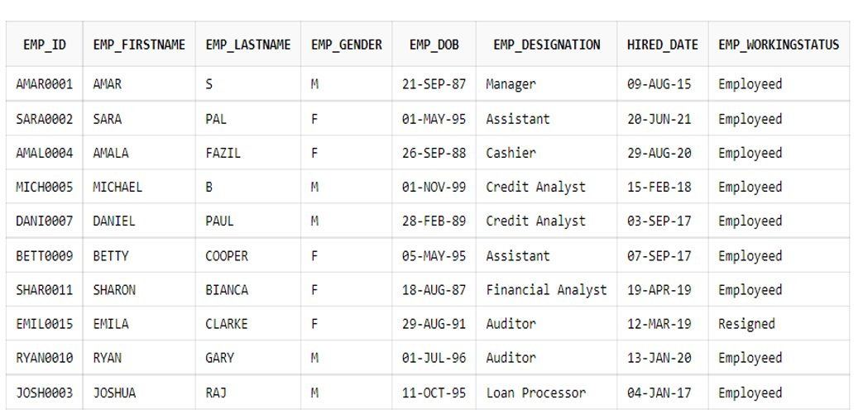
EMPLOYEE TABLE

Slide 27
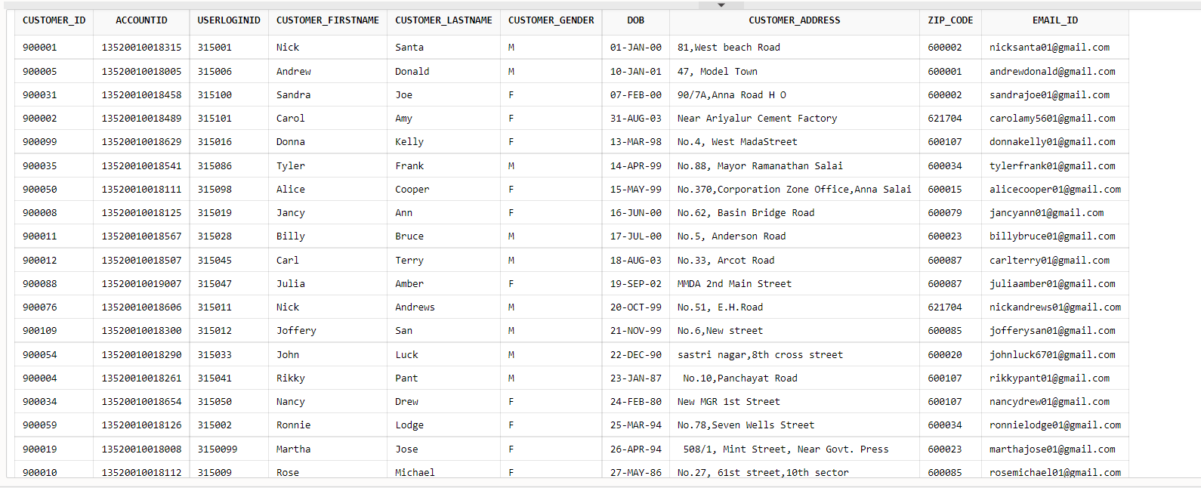
CUSTOMER TABLE

Slide 28
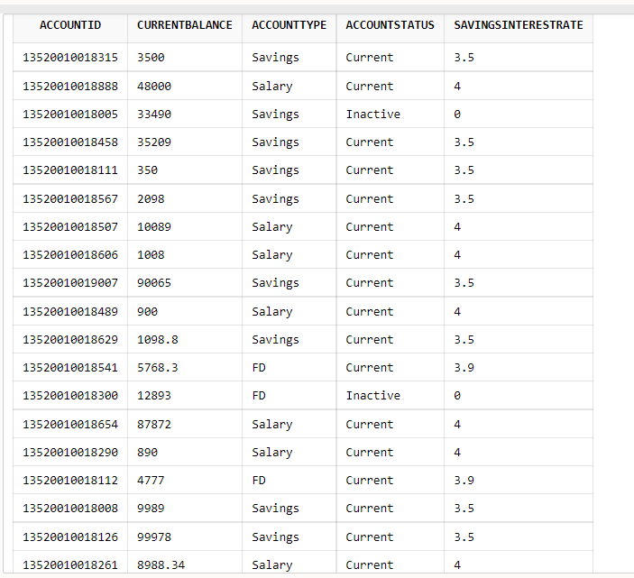
ACCOUNT_DETAILS

Slide 29
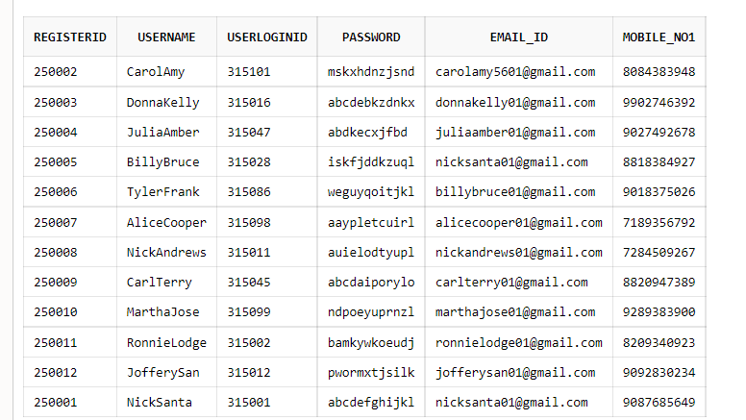
REGISTRATION

Slide 30
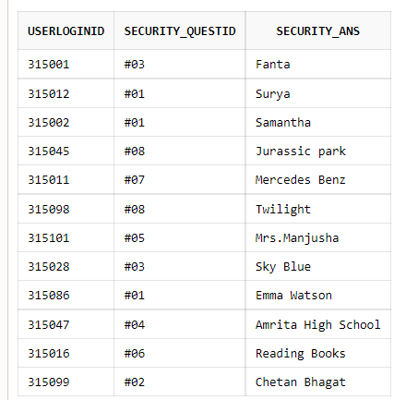
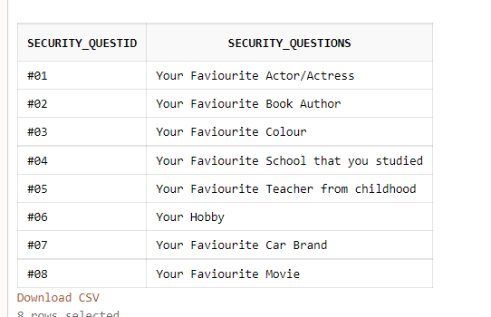
SECURITY QUESTION AND ANSWER

Slide 31
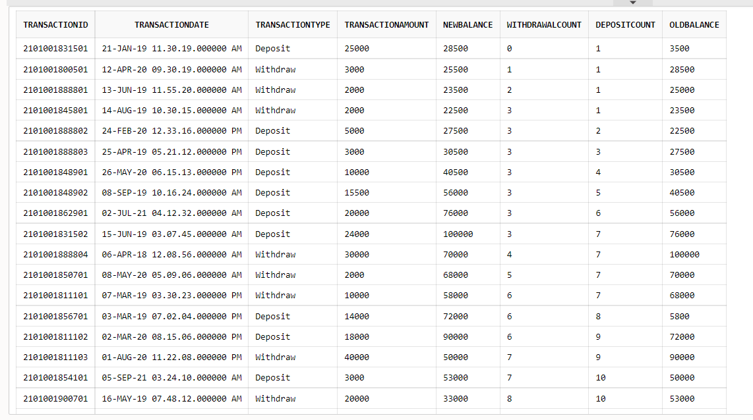
TRANSACTION

Slide 32
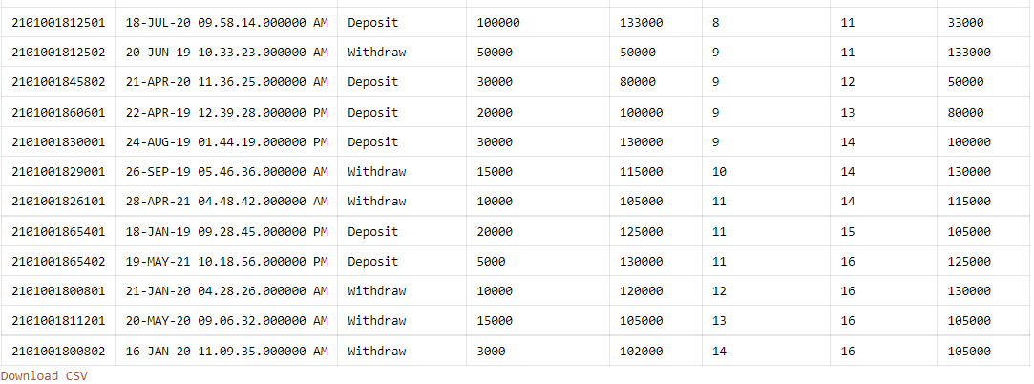
CONDT....

Slide 33
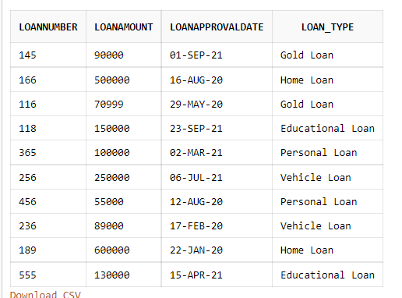
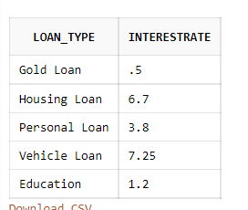
LOAN DETAILS AND TYPES

Slide 34
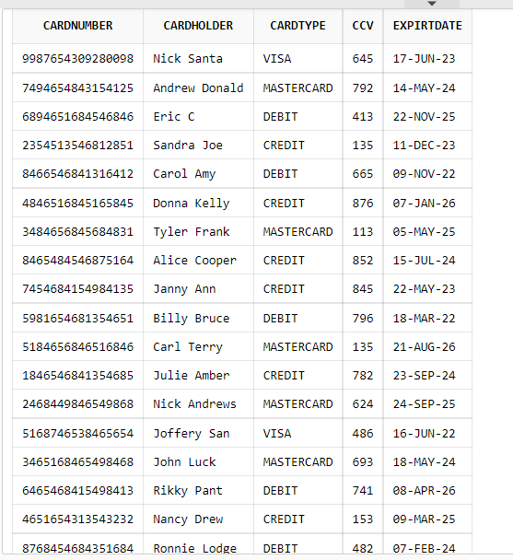
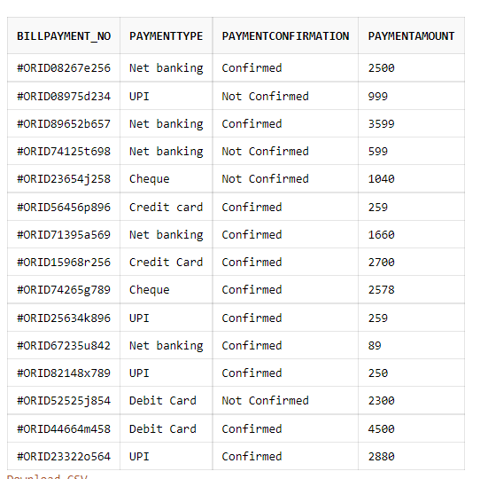
CARD_DETAILS AND BILL_PAYMENTS

Slide 35
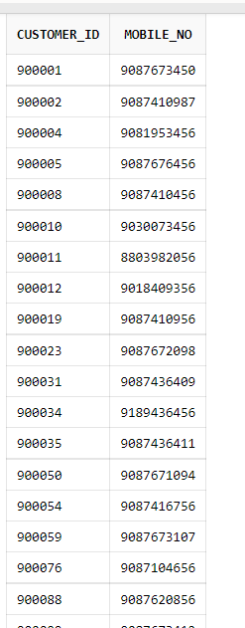
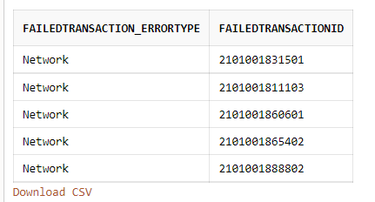
FAILED_TRANSACTION AND CUS_MOBILE

Slide 36
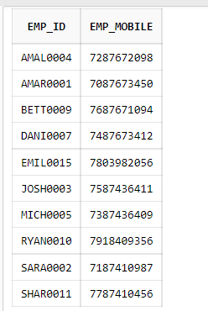
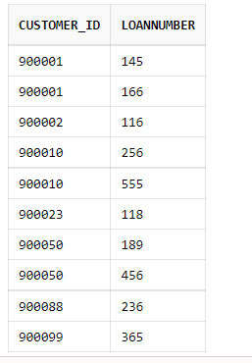
EMP_NUMBER AND LOAN_CUSTOMER

Slide 37
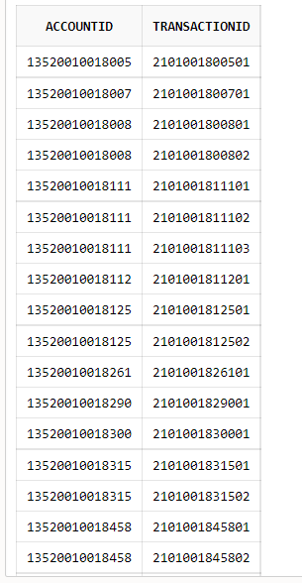
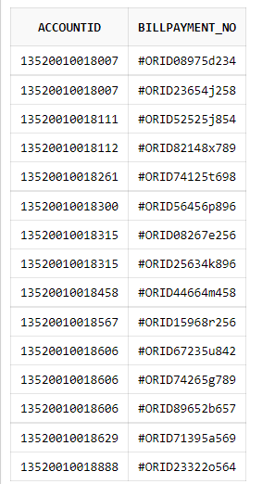
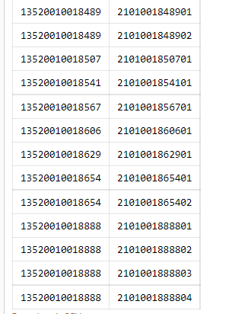
ACC_TRANSACT AND ACC_BILL

Slide 38
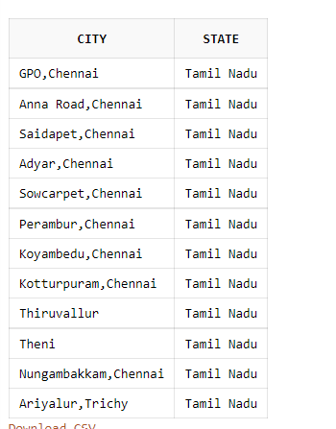
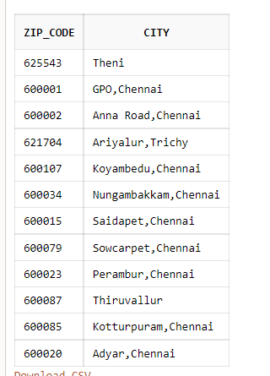
STATE_CITY AND ZIP

Slide 39
USER INTERFACE

Slide 40
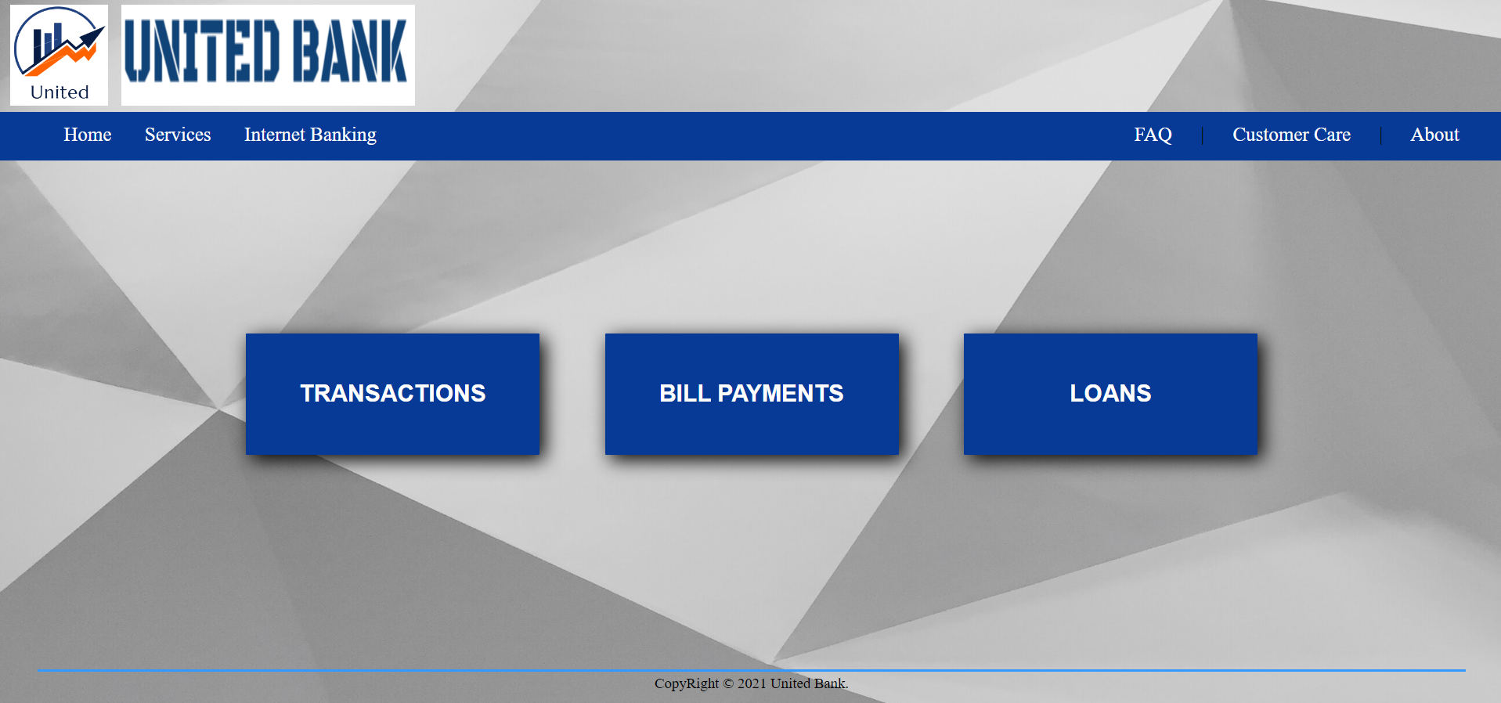
HomePage

Slide 41
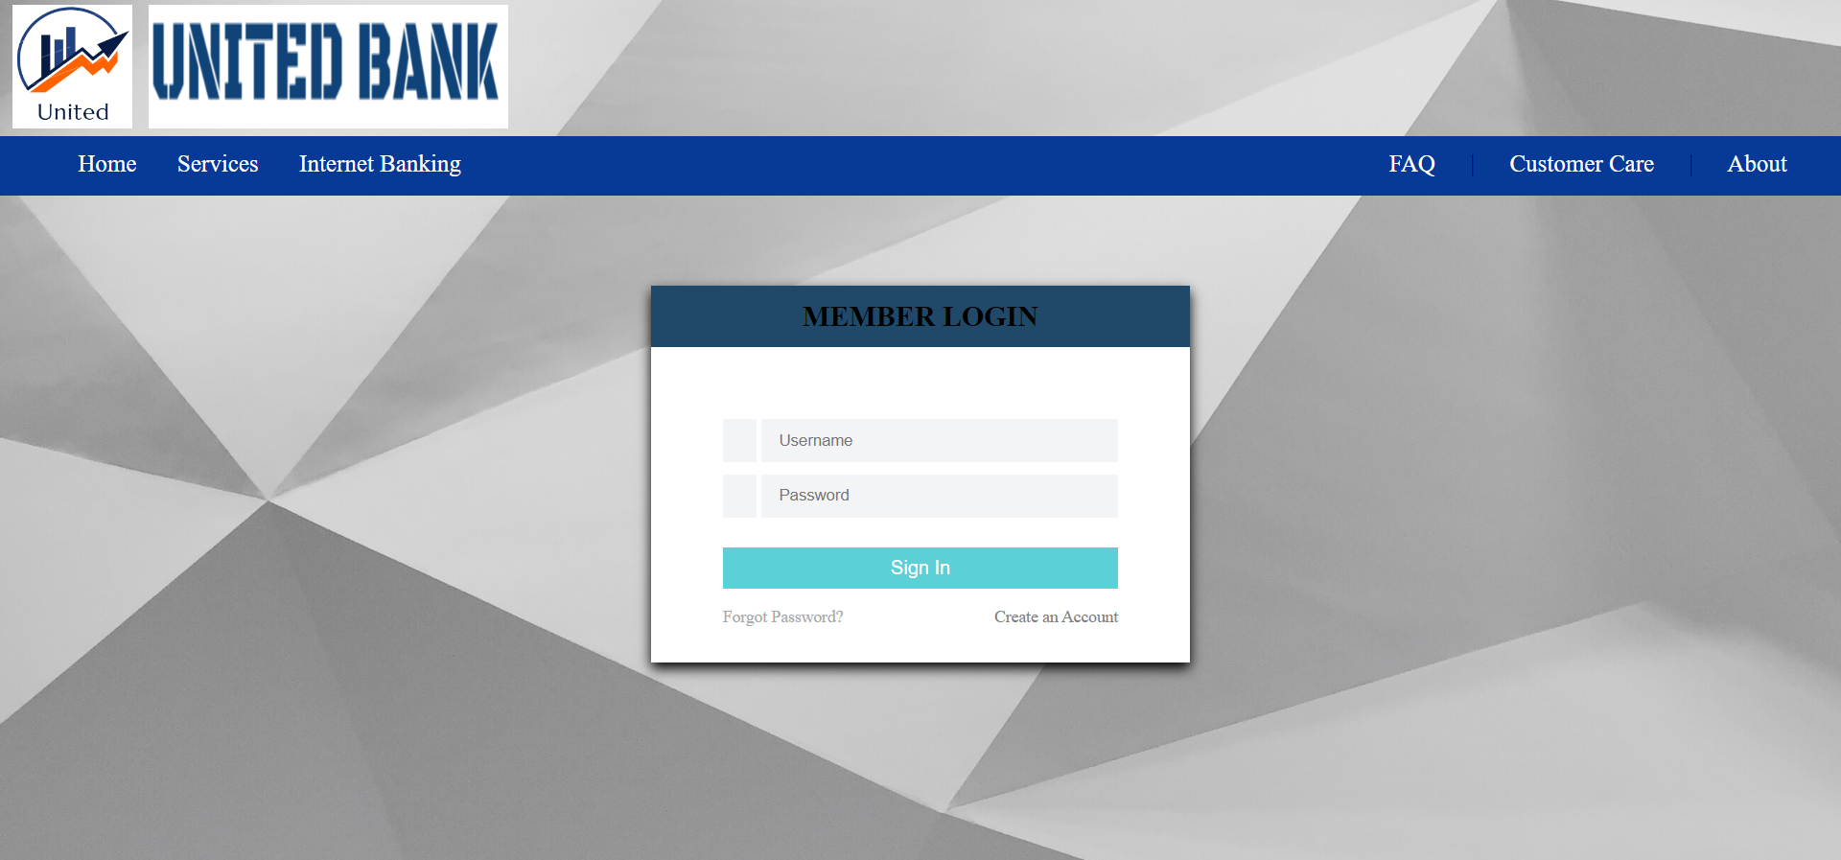
Admin Login

Slide 42
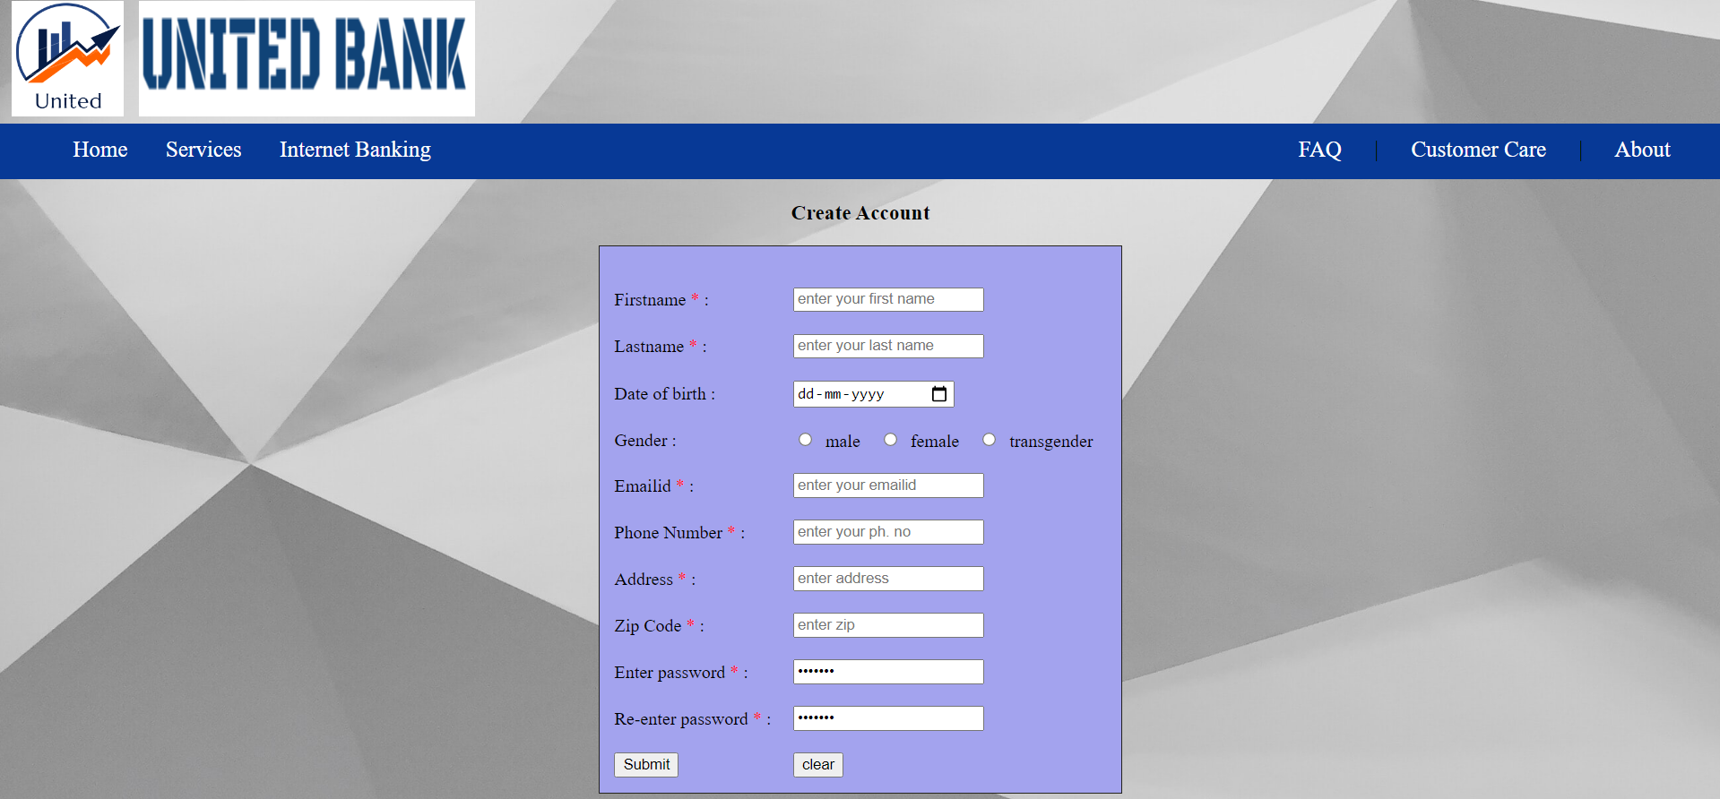
Registration

Slide 43
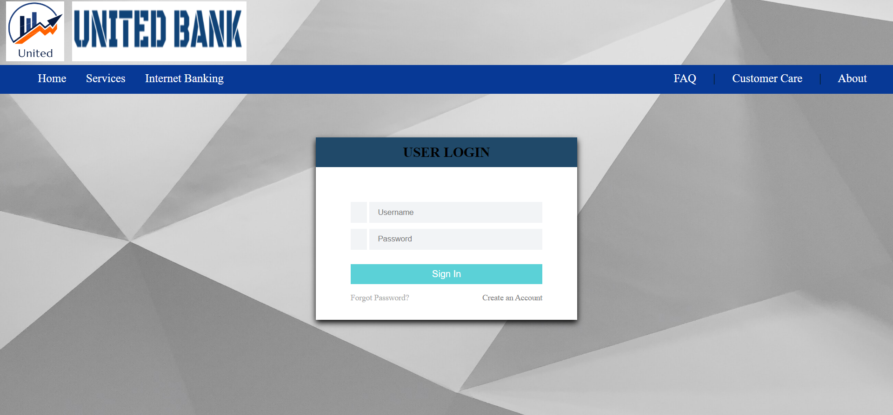
User Login

Slide 44
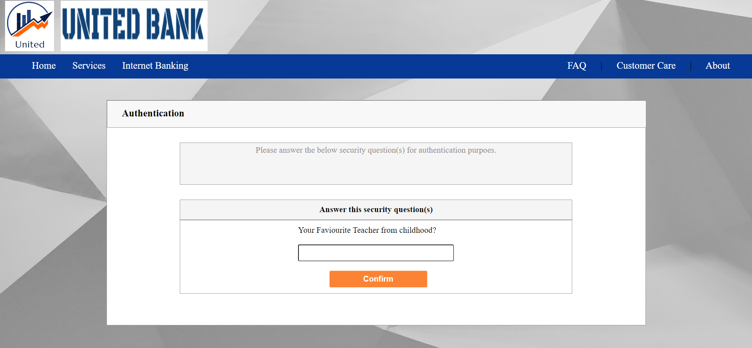
Security Check

Slide 45
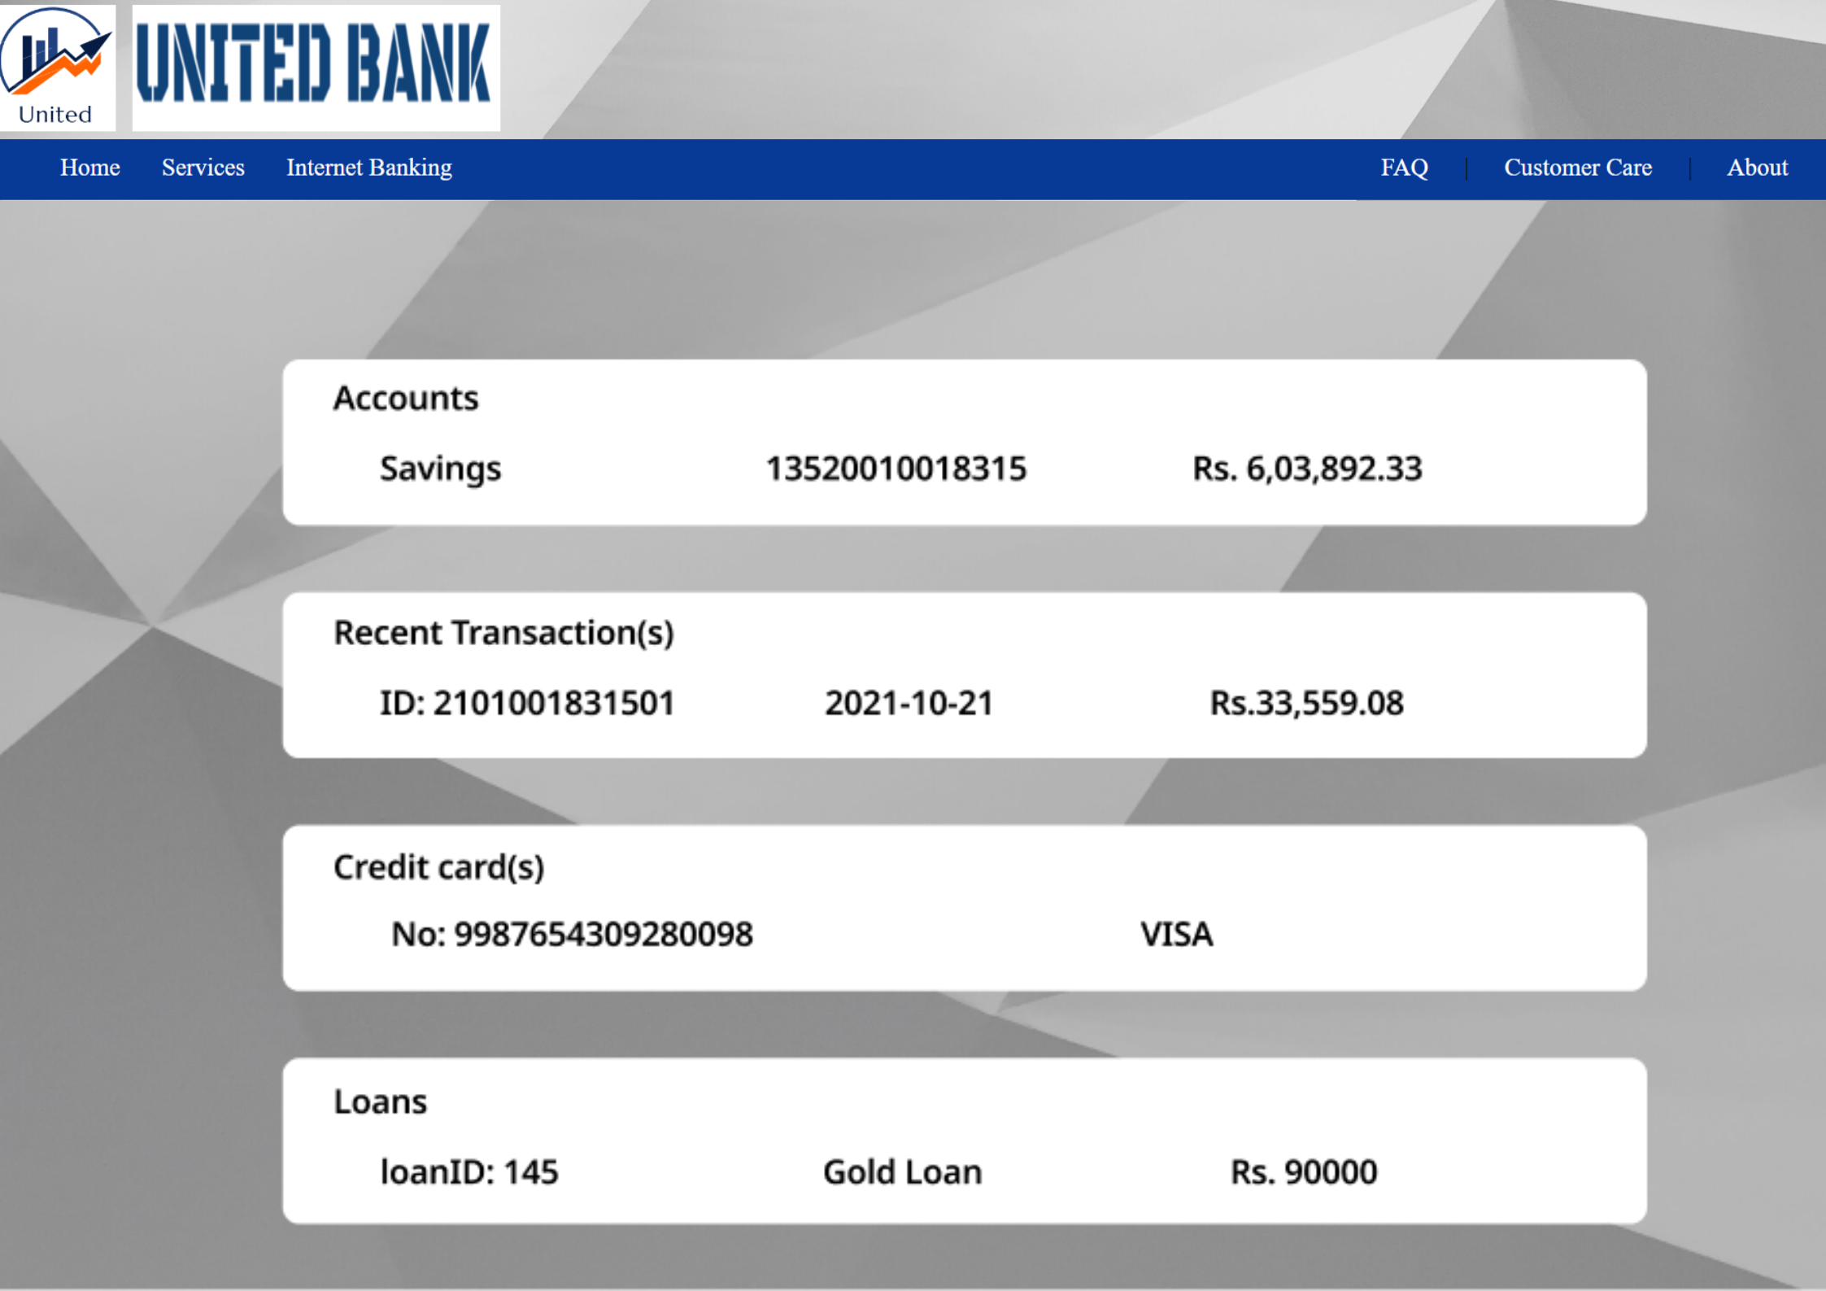
User Acc (Static)

Slide 46
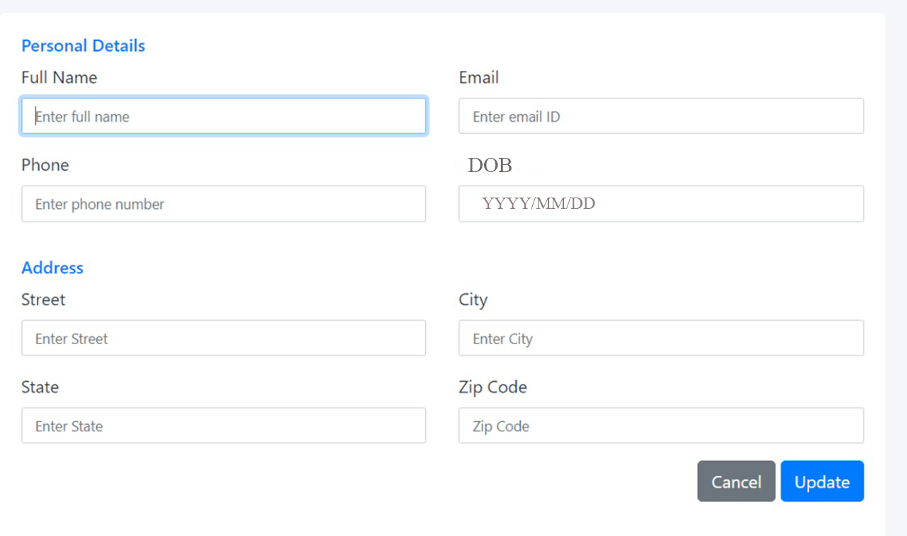
User Details Updation

Slide 47
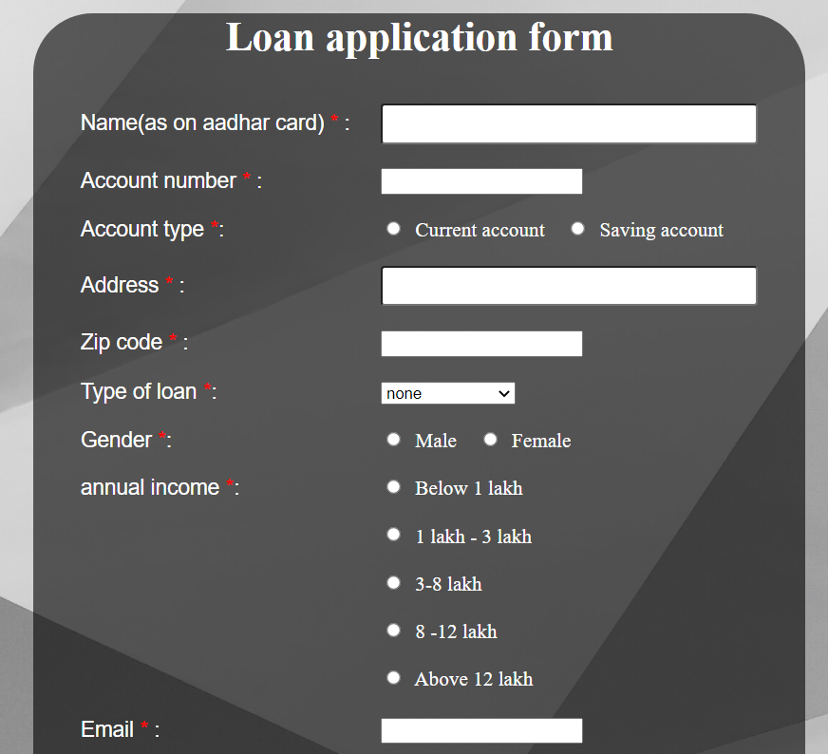
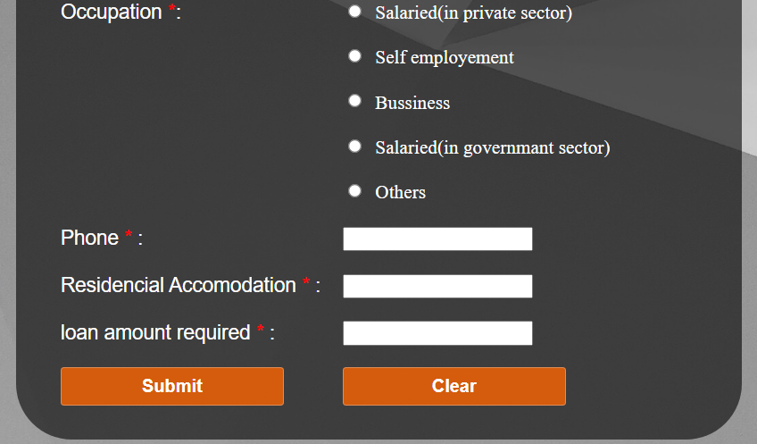
Loan Form

Slide 48
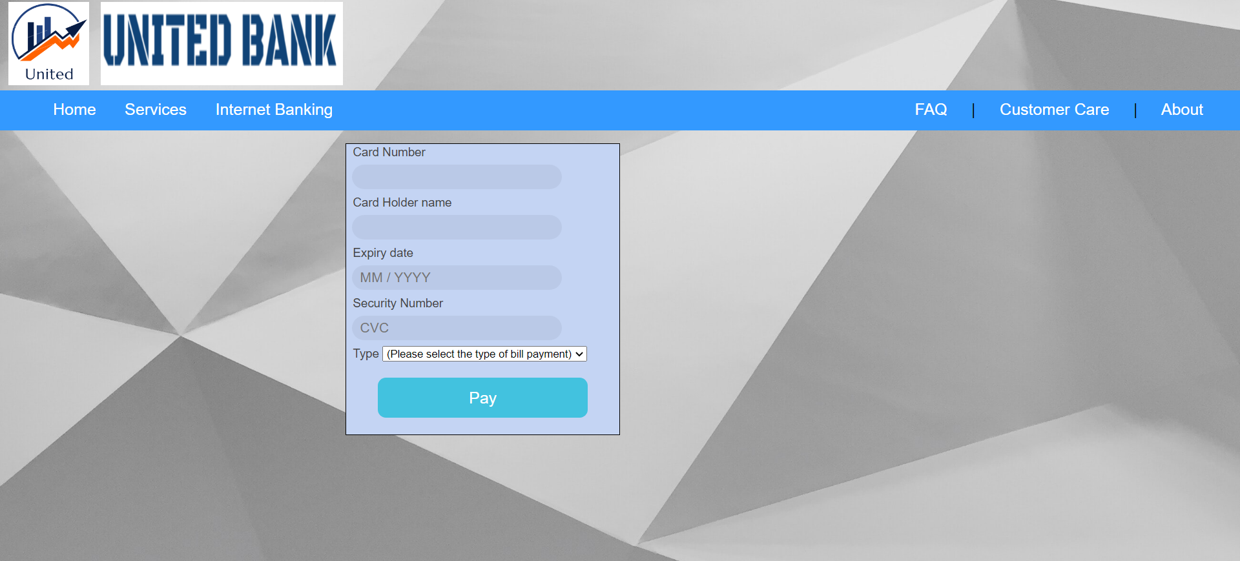
Bill Payment

Slide 49
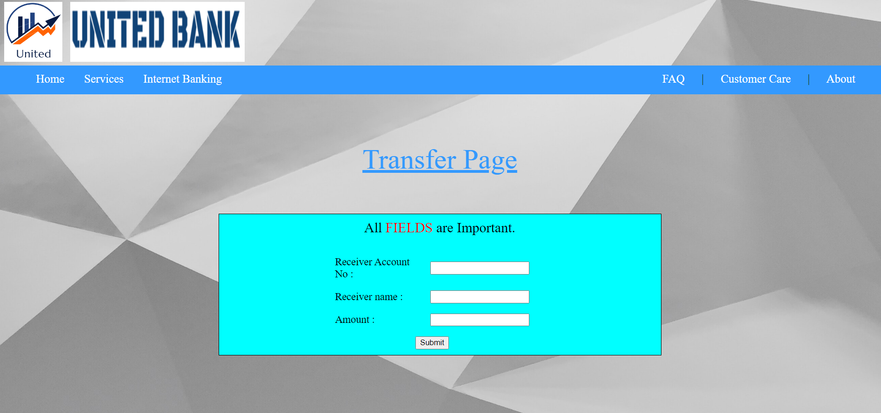
Transfer

Slide 50
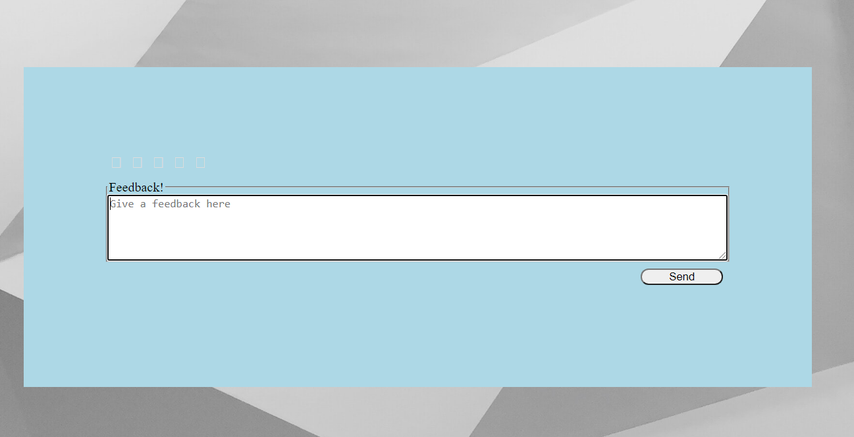
Feedback

Slide 51
CONCLUSION//

Slide 52
TEAM MEMBERS
S.NO | NAME | ROLL NUMBER | WORK DONE
1 | SHARON BIANCA R | CB.EN.U4CSE20258 | Normalization, Table Creation And Documentation
2 | TEJASWINI BOYAPATI | CB.EN.U4CSE20266 | UI Design, EER And Documentation
3 | ASHISH YENEPURI | CB.EN.U4CSE20271 | UI Design
4 | NITHEESH M | CB.EN.U4CSE20244 | UI Design And EER

